Slide 1
Time Series Analyisis – The Concept of Co-integration using R

Slide 2
Contents
Concept of Co-integration
What is Pairs Trading
Co-integration and Pairs Trading
Engle-Granger Test
EG Test in R

Slide 3
Concept of Co-integration
The stock prices are believed to be non-stationary in nature.
If there exists a linear combination of 2 stock prices , such that errors of the long term relationship are stationary (mean reverting) in nature, then the 2 stocks are said to be co-integrated.
Engle - Granger test is used to identify the co-integrated pairs in a particular sector.

Slide 4
Co-Integration
Examples of Co-integrated Series
Income and Consumption
Money, National Incomes, Price Rates, Interest Rates
Prices of Two Stocks
Price of a Commodity and Taxes Levied on that Commodity, Inflation Rate
Temperatures, Electricity Consumption

Slide 5
Co-Integration-Formal Definition
“Order of integration” tells you the minimum number of differences needed to get a stationary series.
A series of successive differences, d, can transform the time series into one with stationarity. The differences are denoted by I(d), where d is the order of integration.
Suppose Y_{t} and X_{t} are two time series integrated of order d, then
Any linear combination of such two series will also be integrated of order d (denoted as I(d)). This is called ‘Integration’
However,
The idea of cointegration was introduced by Engle and Granger in 1987
If there exists a vector β such that u_{t} = Y_{t} – βX_{t} is of a lower order of integration ( I(d – b), where b > 0 ) then Y_{t} and X_{t} are defined as Cointegrated of order (d,b)
*
Usually, the order of integration is either I(0) or I(1); It’s rare to see values for d that are 2 or more.

Slide 6
What is Pairs Trading
Pairs trading finds its roots in the area of securities trading
A quest to generate returns, irrespective of market behavior, has led to the evolution of this strategy
Certain securities, often competitors in the same sector, are associated in their day-to-day price movements. When the association breaks down, Traders take advantage of short term over pricing or under pricing of securities & invest accordingly, betting that the "spread" between the two would eventually converge
Pairs Trading strategy works best in volatile market conditions

Slide 7
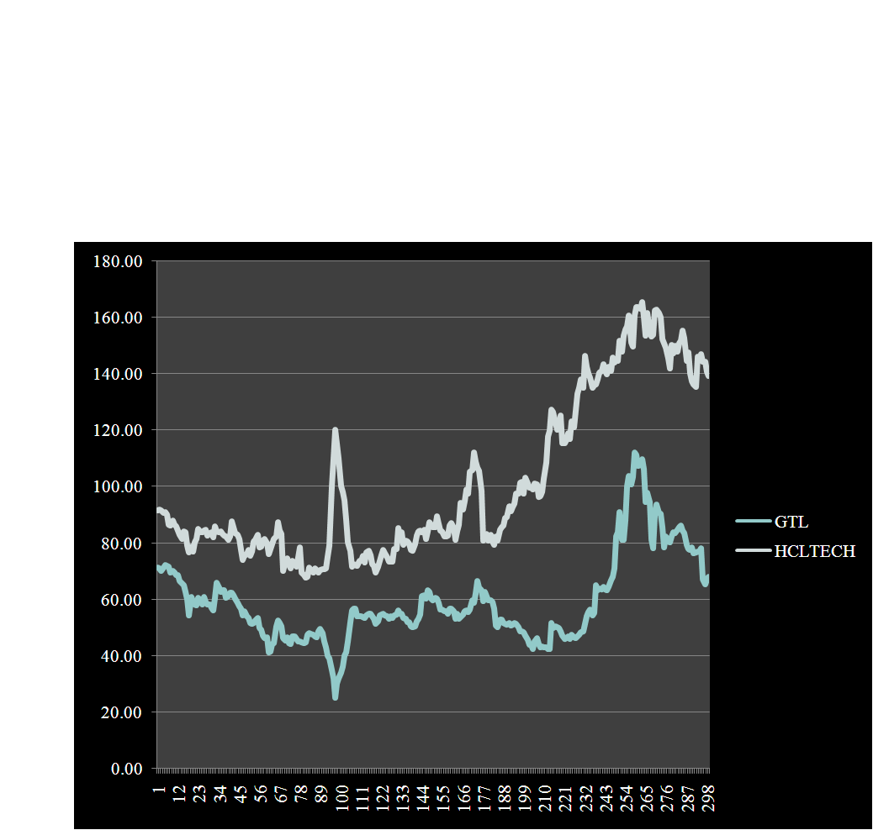
Simple Example of Pairs Trading
Fig. 1: Pairs Trading
This is the right opportunity for Pairs Trade
TRADER WILL GAIN PROFIT IF HE SELLS HCLTECH AND BUYS GTL

Slide 8
Co-Integration and Pairs Trading
The stock prices are believed to be non-stationary in nature.
If there exists a linear combination of 2 stock prices , such that errors of the long term relationship are stationary (mean reverting) in nature, then the 2 stocks are said to be co-integrated.
Pairs trading is in fact an extended application of the theory of co-integration.
Engle -Granger test is used to identify the co-integrated pairs in a particular sector.

Slide 9
Engle Granger Test for Stock Prices
Let Y_{t} : TCS stock price at time t
Let X_{t} : IBM stock price at time t
Both the stock prices form non-stationary time series over time t.
If there exists a linear combination, such that the errors form stationary time series then TCS and IBM stocks are said to be co-integrated.
α = model intercept
β = regression coefficient
ε_{t} = error term
Y_{t} = α + β X_{t} + ε _{t}

Slide 10
Engle Granger Test for Stock Prices
Regression coefficient β is estimated using ordinary least square (OLS) method
If β < 0 then the pair is discarded
Selection of regression equation is done by comparing β
The equation with higher β is selected
In case of TCS and IBM stocks β1 > β2 hence equation 1 was selected
Y_{t} = α₁ + β₁ X_{t} + ε _{t} ……….1
X_{t} = α₂ + β₂ Y_{t} + ε _{t} ……….2

Slide 11
Engle Granger Test
Engle Granger test is used to check stationarity of error time series.
Consider,
Δ ε _{t} =ε _{t} - ε_{t-1}
ε _{t-1} = errors with lag 1
Δ ε _{t} = γ* ε _{t-1}+ W_{t}
Objective | To test the null hypothesis that time series is not stationary
Null Hypothesis H0: Two stocks are not co-integrated
Alternate Hypothesis H1: Two stocks are co-integrated
Test Statistic | (γ*/SE(γ*)) Test statistic follows DF distribution under null
Decision Criteria | Reject the null hypothesis if tcal < c(p)

Slide 12
Engle Granger Test in R
# Installing and Loading Required Packages
quantmod is a very popular financial analysis package.
egcm stands for Engle Granger Cointegration Models
install.packages("quantmod") install.packages("egcm") library(quantmod) library(egcm)
#EG Test
getSymbols(c("tcs","ibm"), from = "2016-11-01", to = "2017-11-01", env = .GlobalEnv, src = "yahoo") summary(egcm(TCS[,4],IBM[,4]))
getSymbols() fetches data from various sources. The command requires us to specify start and end dates of the prices required.
Symbols a character vector specifying the names of each symbol to be loaded
env where to create objects.
src character string specifying sourcing method (yahoo, google, MySQL, FRED, csv, RData, oanda, and av)
ecgm() performs a simple two-step EG test on a pair of time series.
egcm(X,Y) considers Y on the LHS and X on the RHS of the model while searching for parameters α, β, and ρ that yield best fit to the following model: Y_{t} = α + β X_{t} + ε _{t}

Slide 13
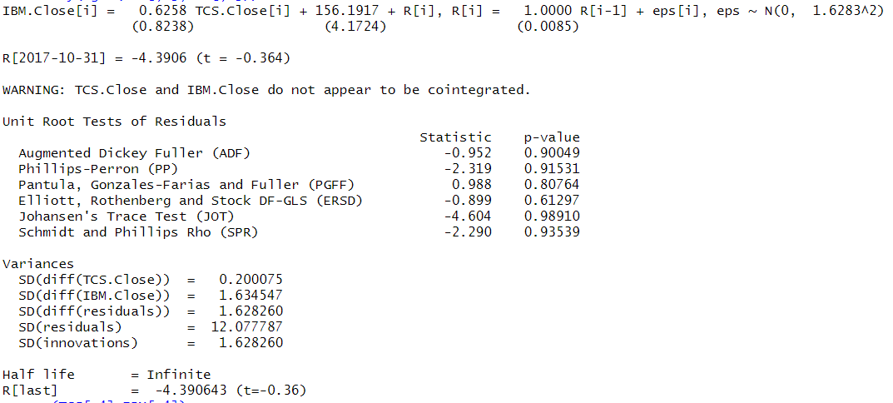
Engle Granger Test in R
# Output
Interpretation :
Stocks TCS & IBM are not cointegrated.
?
What if we want to get data from other sources?
There are different packages using database APIs for data from other indices, eg. Quandl for India’s National Stock Exchange (NSE) prices

Slide 14
Get an Edge!
There are a number of alternative approaches for testing co-integration, apart from the Engle Granger test, such as
CRDW (Cointegrating Regression Durbin Watson) test → Simple regression of one variable on the other, and the standard Durbin-Watson test on the residuals.
Error Correction Test → The tendency of cointegrated variables to revert to common stochastic trends is expressed in terms of error-correction
Johansen’s Multivariate VAR Approach → Examines the number of independent linear combinations (k) for an m time series variables set that yields a stationary process

Slide 15
Quick Recap
In this session, we learnt about co-integration in time series:
Co-integration
When the time series is integrated and linear combination of variables in that series is also integrated, but having an order lower than the whole series, then the variables are said to be co-integrated.
Pairs Trading
When the association between two cointegrated stocks breaks down, Traders take advantage of short term over pricing or under pricing of securities & invest accordingly, betting that the "spread" between the two would eventually converge.
EG Test in R
A combination of packages quantmod and ecgm is used to perform Engle Granger test in R, to check if a pair of time series is co-integrated.

